Slide 1



YOWOMO
Education and Training for Youth Work
in the Age of Smartphones and Social Media
Lutz Siemer, coordinator YOWOMO2.0 & YOWOMO2.0-Train

Slide 2
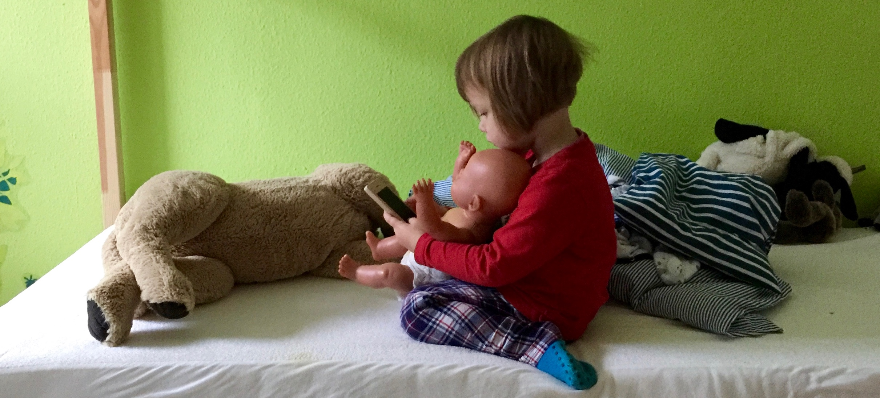


A picture tells a thousand words

Slide 3
Content
Digitality and youth
Challenges for professionals
YOWOMO2.0
YOWOMO2.0-Train

Slide 4
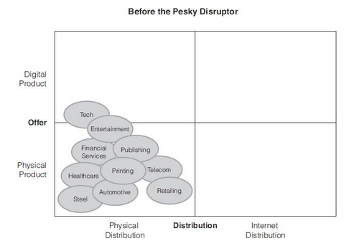
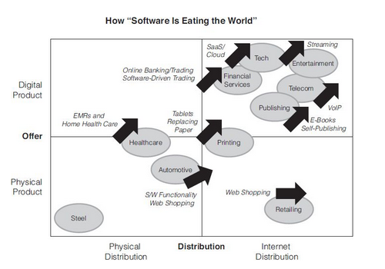
Digitalisation
Wood, J. B. (2014). B4B: How Technology and Big Data Are Reinventing the Customer-Supplier Relationship

Slide 5
“I've come up with a set of rules that describe our reactions to technologies:
Anything that is in the world when you’re born is normal and ordinary and is just a natural part of the way the world works.
Anything that's invented between when you’re fifteen and thirty-five is new and exciting and revolutionary and you can probably get a career in it.
Anything invented after you're thirty-five is against the natural order of things.”

Slide 6
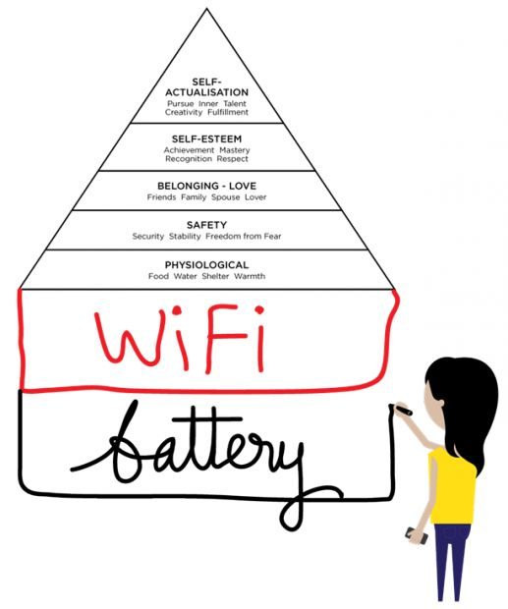
Background
The digital world is increasingly becoming a natural habitat for children and adolescents, particularly the rising importance of smartphones and social media.
Digitality is a challenge for the educational practice of youth work, school social work, youth care and related fields.

Slide 7

Digitality and youth
Young people are permanently online – the internet has been in their pockets since the day they were born.

Slide 8


Digitality and youth - phenomena
Smart Mobile Devices
Social Network Services

Slide 9
Challenges for youth work professionals
Digital Youth Work
Basic competences
Organisational framework
Open-minded attitude
Nach Barbara Buchegger/Louise Horvath: Europäische Perspektiven auf Herausforderungen der digitalen Jugendarbeit, merz 2017/04: Soziale Arbeit digital

Slide 10
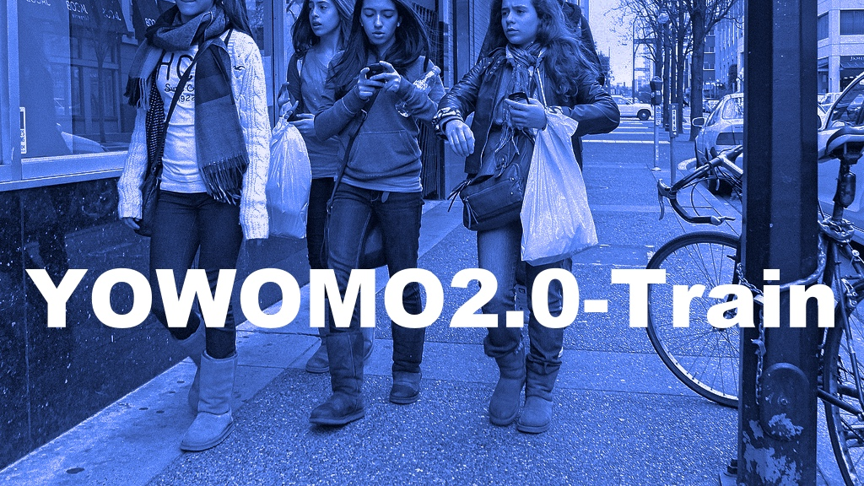
YOWOMO ... ???
YOWO Youth Work
MO Mobiles (Smartphones)
2.0 Web 2.0 (Social Media)
Train Training

Slide 11


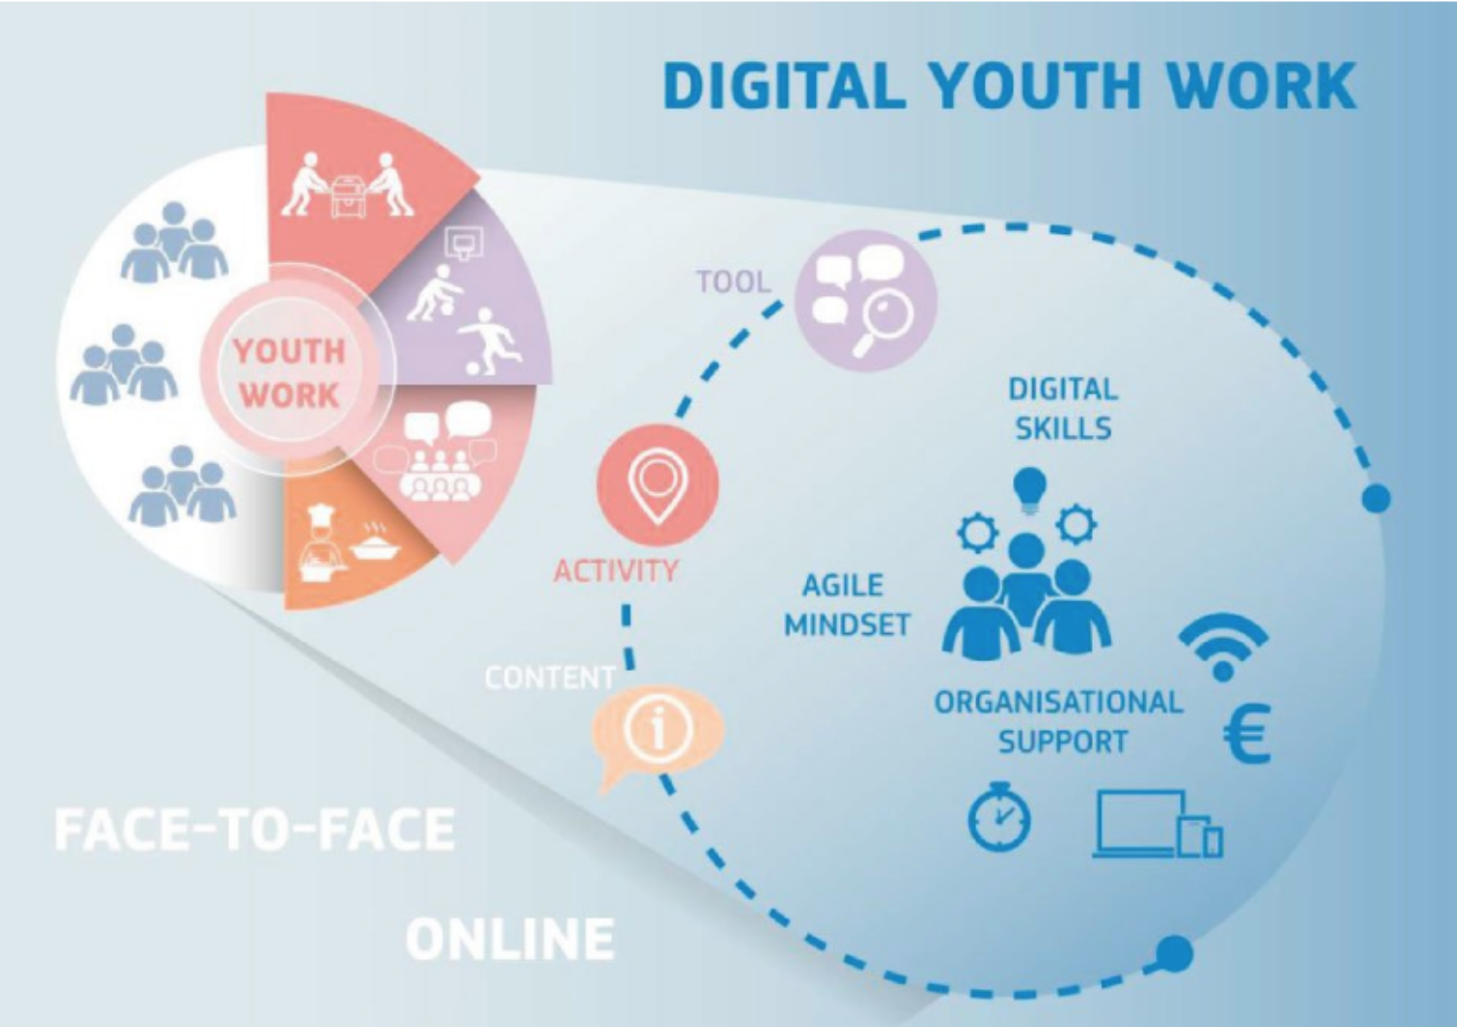
Landscape
 |  |  | YOWOMO2.0 |  |  | YOWOMO2.0-Train
... | 2011 | 2012 | 2013 | 2014 | 2015 | 2016 | 2017 | 2018 | 2019
EU Kids Online I - IV
 |  |  | Net Children Go Mobile |  | Screenagers
 |  |  |  |  |  | Developing Digital Youth Work

Slide 12

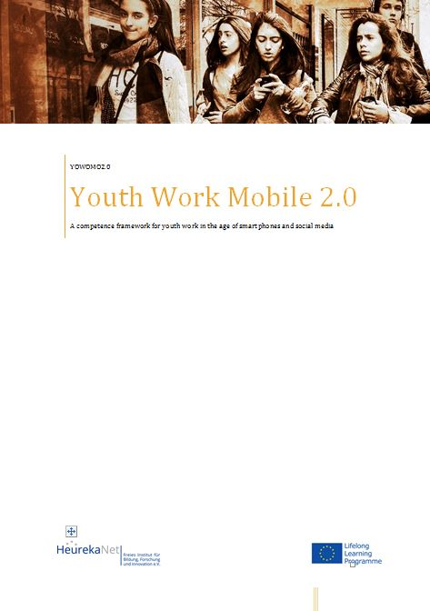
YOWOMO2.0 (2013-2015)
A competence framework for working with children and young people in the age of smart mobile devices and social networking sites
  10 Competences described as bodies of knowledge, skills & attitude
  Measuring instruments (Quiz)
  Professional products (proof of competence) and evaluation criteria
  Training scenarios

Slide 13
YOWOMO2.0 Competences

Slide 14




YOWOMO2.0 Piloting & dissemination
Pilot: Saxion Universtiy of Applied Sciences – Social Work
Pilot: LWL Jugendheim Tecklenburg – In-house Training in resedentional youth care
Publication: „Der Pädagogische Blick“
Conferences

Slide 15



YOWOMO2.0-Train (2016-2019)
European Partnership (Erasmus+)
Education and training based on the YOWOMO2.0 competence framework
Qualification of professionals for "Youth work in the age of smartphones and social media"
Piloting 2018
Launch 2019

Slide 16
Partners
ASEV - AGENZIA PER LO SVILUPPO DELL'EMPOLESE VALDELSA (Italy)
H@BDER - HAYATBOYU OGRENME AKADEMISI DERNEGI (Turkey)
HeurekaNet - Freies Institut für Bildung, Forschung und Innovation e.V. (Germany)
Pro Art & Co (UK)
ProF - Fundatia Professional (Romania)
Saxion University of Applied Sciences (The Netherlands)
ServiceBureau Jugendinformation (Germany)
SYNTEA SPOLKA AKCYJNA (Poland)
UŞAK İL MİLLİ EĞİTİM MÜDÜRLÜĞÜ (Turkey)

Slide 17

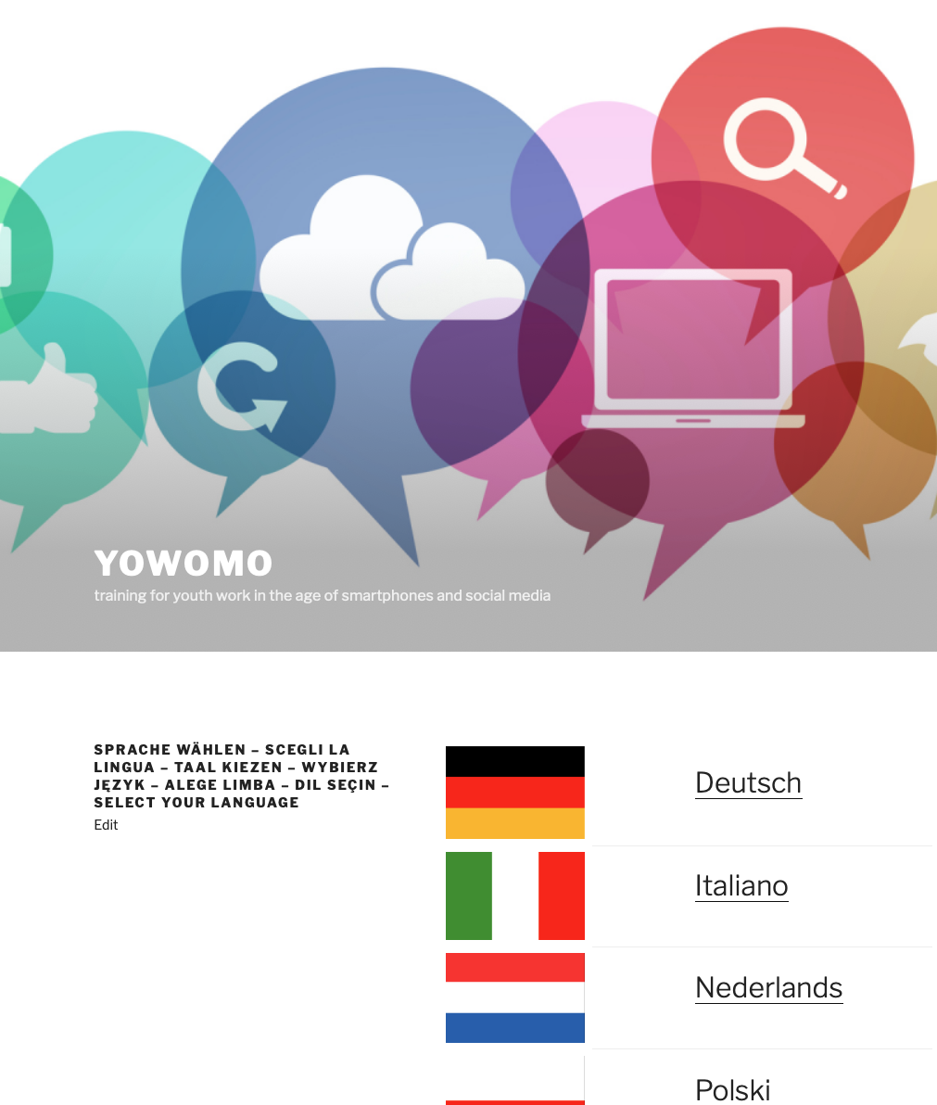
YOWOMO2.0-Train Output
Train-The-Youth Worker
  Training material in 7 languages
  MOOC (English)
Train-The-Trainer
  Training material in 7 languages
  MOOC (Englisch)
  -> YOWOMO.EU

Slide 18
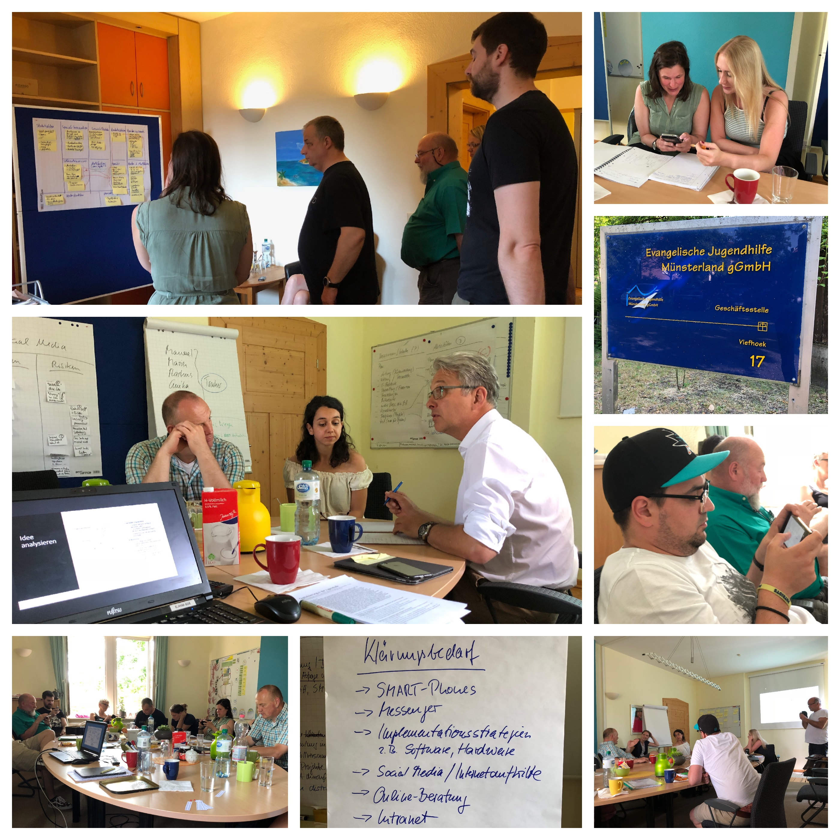
YOWOMO
Train-The-Youth Worker
7 modules:
Digital relationship
Online attitude
Ethics and practice
Legal framework
Social media and public relations
Professional network
Quality management

Slide 19

Discussion

