Slide 1
Blended Smoking Cessation Treatment (BSCT):
Description of Patients’ User Experience (UX)
Wetenschapsdag Medisch Spectrum Twente 18 April 2019 - Lutz Siemer

Slide 2
Background: Blended Smoking Cessation Treatment (BSCT)
Smoking tobacco
  is one of the biggest public health threats.
Smoking cessation
  reduces the risk of developing smoking-related diseases.
Blended Smoking Cessation Treatment (BSCT)
  combines the strengths of face-to-face (F2F) treatment with the unique features of Web-based care
  is a “promising way” to deliver behavioral change interventions
  may be the ”best of both worlds”?

Slide 3
Background: User Experience (UX)
Definition: “… what people personally encounter, undergo, or live through while using, interacting with, or being confronted passively with systems/services”
UX impacts use of health services and by this adherence to BSCT and ultimately quitting

Slide 4
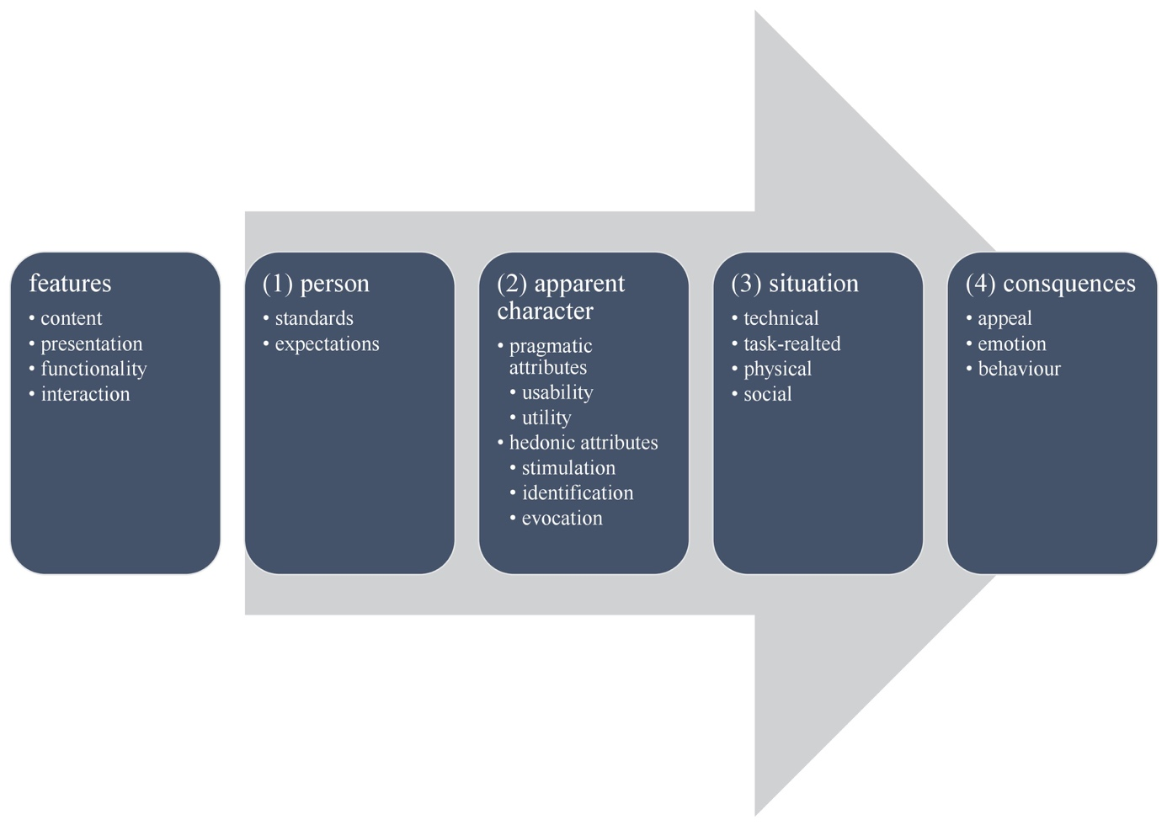
Hassenzahl‘ process model of UX from a user‘s perpective

Slide 5
Aim
….to use Hassenzahl’s model of UX to qualitatively describe patients’ UX of a blended smoking cessation treatment (BSCT) in routine care.

Slide 6
Method: Data collection and analysis
10 in-depth semi-structured interviews
Qualitative analysis based on the key elements which form the UX from a user perspective
“Positive” vs. “negative”
  Patients’ standards and expectations
  Apparent character
    Pragmatic attributes
      Usability
      Utility
    Hedonic attributes
      Stimulation
      Identification
      Evocation
  Usage situation
    Physical
    Social
    Technical
    Task
  Consequences
    Appeal
    Emotion
    Behavior

Slide 7
Method: Study Participants
Patients included in an RCT on the effectiveness of BSCT versus F2F-treatment as usual
Outpatient smoking cessation clinic at the Medical Spectrum Twente hospital (Enschede/The Netherlands)
Inclusion criteria
  being at least 18 years old,
  currently smoking (at least one cigarette a day)
  having access to email and internet
  being able to read and write Dutch
Purposive sample (n=10) (striving for an heterogeneous mix)

Slide 8
Method: Study Intervention (BSCT)
A combination of F2F-treatment and Web-based sessions blended into one integrated smoking cessation treatment delivered in routine care settings
Consists of 5 F2F sessions at the outpatient clinic and 5 Web-based sessions (50-50 balance between F2F and Web)
High-intensity treatment (6h total) derived from the Dutch Guideline Tobacco Addiction, fulfilling the requirements of the Dutch care module for smoking cessation

Slide 9
Results: 1. Patients’ standards and expectations
Positive-pragmatic standard
  Earlier stop smoking attempts
    “You just have to do the things” (#53)
  ICT-use in general
    “Computer is a tool” (#509, #75)
Neutral-open expectation
  „is new and sounds interesting“ (#14)
  Expecting support
    Counselor shall be „a driving force“ (#10)
    „get more grip on smoking cessation“ (#34)

Slide 10
Results: 2. Apparent character
Pragmatic: positive
  Usability ... “there have been no problems” (#509), “all was quite logical” (#14)
  Utility ... “all BSCT parts were helpful – some more, some less” (#53), “matched my quitting process” (#53)
Hedonic: ambivalent
  Stimulation … “quit smoking” (#14), “discuss costs of smoking” (#12), “think” (#106, #34), … “online won’t get through to me” (#53, #34, #14, #25)
  Indentification ... “perseverance” (#75), “self-control” (#75), ... “felt treated like a child” (#27), … “online is not my style” (#12, #75, #10, #25)
  Evocation … Web-sessions like “bookkeeping” (#53, #34, #14), “filling in tax forms” (#10)

Slide 11
Results: 3. Usage situation
Technical: negative ... “did not work on iPad” (#34, #10, #25, #75), “had to start up the laptop, which takes time” (#106, #34, #14)
Task: negative .. Not enough time “because of other tasks” (#509), “because of family tasks” (#106)
Physical: positive ... Web-sessions at “my own home office” (#25, #509), “hobby room upstairs, which is a nice place” (#10)
Social: positive ... everyone “supported” (#53, #25), “complimented” (#53), “family motivated stopping” (#106)

Slide 12
Results: 4. Consequences
Appeal: positive
  BSCT in general: „good“(#106, #53, #27, #75, #14, #25), “offered variety” (#75)
  Web-sessions: “yielded nothing” (#509, #75, #14), “a lot” (#509, #27), “cumbersome” (#106), “boring” (#34, #27), “tiring” (#27), “nonsense” (#12, #10), “dead” (#10)
Emotion: ambivalent
  BSCT in general: “not satisfied” (#34, #25), “satisfied” (#27, #10), “thankful” (#106), “feeling abandoned, left alone” (#12);
  Web-sessions: “unpleasant” (#27), “making me nervous” (#34)
Behavior: ambivalent
  BSCT in general … adherend (#14, #53, #25)
  Web-sessions: “sloppy” (#106, #34, #27, #10, #25)
  Successful quitting (#10, #14, #106, #53).

Slide 13
Main findings
UX: BSCT in general positive
Standard: positive-pragmatic
Expectation: neutral-open
Pragmatic attributes: BSCT in general positive
Hedonic attributes: F2F positive <-> Web negative
Appeal: F2F positive <-> Web negative

Slide 14
Implications
Research: Explore role of hedonism in health care
Clinical practice: improve BSCT by adressing heodnism building on e.g. „Persuasive system design“ and „Funology“

Slide 15
Literature
Contact author:
  l.siemer@saxion.nl

